Slide 1
Sextortion & Internet safety
Chief Kent Goodrich
North Park Police Agency

Slide 2

Sextortion-What Parents Should Know
Sextortion: the practice of extorting money or sexual favors from someone by threatening to reveal evidence of their sexual activity.
Sextortion can start on any site, app, messaging platform, or game where people meet and communicate. In some cases, the first contact from the criminal will be a threat. The person may claim to already have a revealing picture or video of a child that will be shared if the victim does not send more pictures.
More often, however, this crime starts when young people believe they are communicating with someone their own age who is interested in a relationship or with someone who is offering something of value.
After the criminals have one or more videos or pictures, they threaten to publish that content, or they threaten violence, to get the victim to provide more images. The shame, fear, and confusion children feel when they are caught in this cycle often prevents them from asking for help or reporting the abuse.

Slide 3
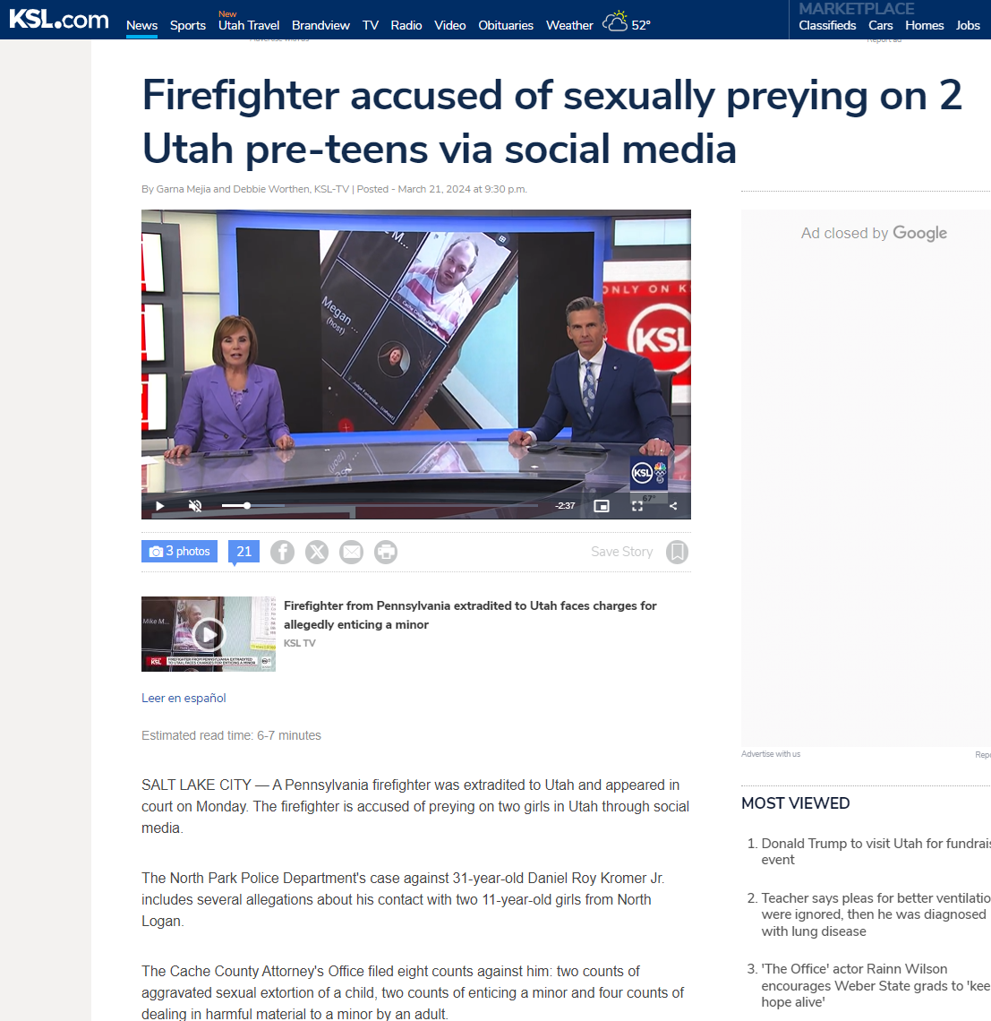
Sextortion: An ever-increasing problem for the valley.
December 18, 2023—NL family seeking answers into the disappearance of their daughter.
March 21, 2024--PA firefighter arrested and extradited to Cache County accused preying on (2) teens.
Fall of 2024 our detectives worked another local sextortion case. The suspect in this case took a plea deal for (9) counts of exploitation, with each count carrying a 5-year sentence.

Slide 4
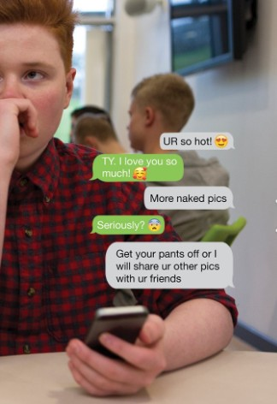
Teen communication
Parents sometimes do not understand how their kids communicate.
Confidence/Identity of teens are tied closely to phone/social media.
False lies and accusations pose a real and heavy threat to teens. These threats come all hours of the day and night.
The majority of teen conversations occurs through their cell phone or apps.
Teens will often use their friend’s cell/electronic device if they cannot use their own.
Teens feel pressure to be liked (or not the target) and fall victim into sharing nude photos.
Once photos are sent, any control over the situation is out of their hands. Teens either continue to send more pictures/money, or risk becoming a target for cyber bulling.
Can lead to suicidal ideology.

Slide 5

Red Flags with your teens
Things to look for:
Sudden changes in behavior, such as becoming withdrawn, anxious, or secretive.
Frequent and excessive use of electronic devices or social media platforms.
Unwillingness to discuss on-line activities or interactions with parents.
4. Unexplained money or gift cards with no explanations as to how they were acquired.
5. Receiving messages from unknown individuals. Sometimes the messages request explicit content or personal information.
6. Teens that express fear or discomfort about certain online interactions or threats made by someone they met on-line.
7. Pay attention when teens abruptly delete social media accounts, threads, or create new accounts to post on.
8. A decline in academic performance or interest in other activities they used to enjoy.
9. Teens that go to a dark place and begin making comments about suicide or begin taking steps to end their life.

Slide 6
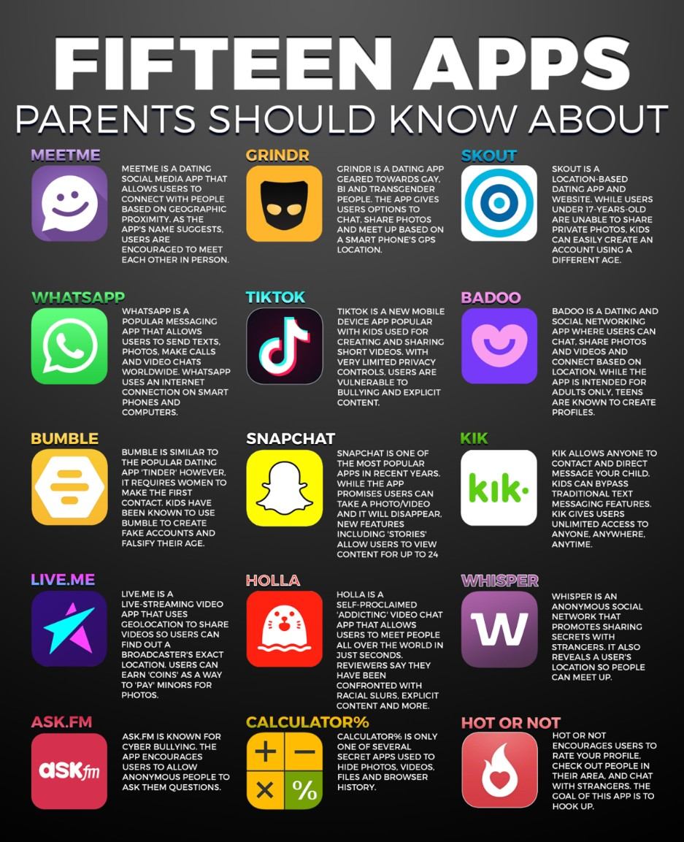
Most Dangerous Apps for Teenagers

Slide 7

Foundational behaviors
Parents, what type of foundations behaviors exist in your home?
  Internet access…when and where is it allowed? Bathrooms, bedrooms, throughout the night?
  What type of time limits have you set for social media/internet/texting access?
  Do you monitor what apps teens have access to? Do they have to have permission to download and install apps?
  Currently, do you review your child’s online presence on a regular basis?

Slide 8
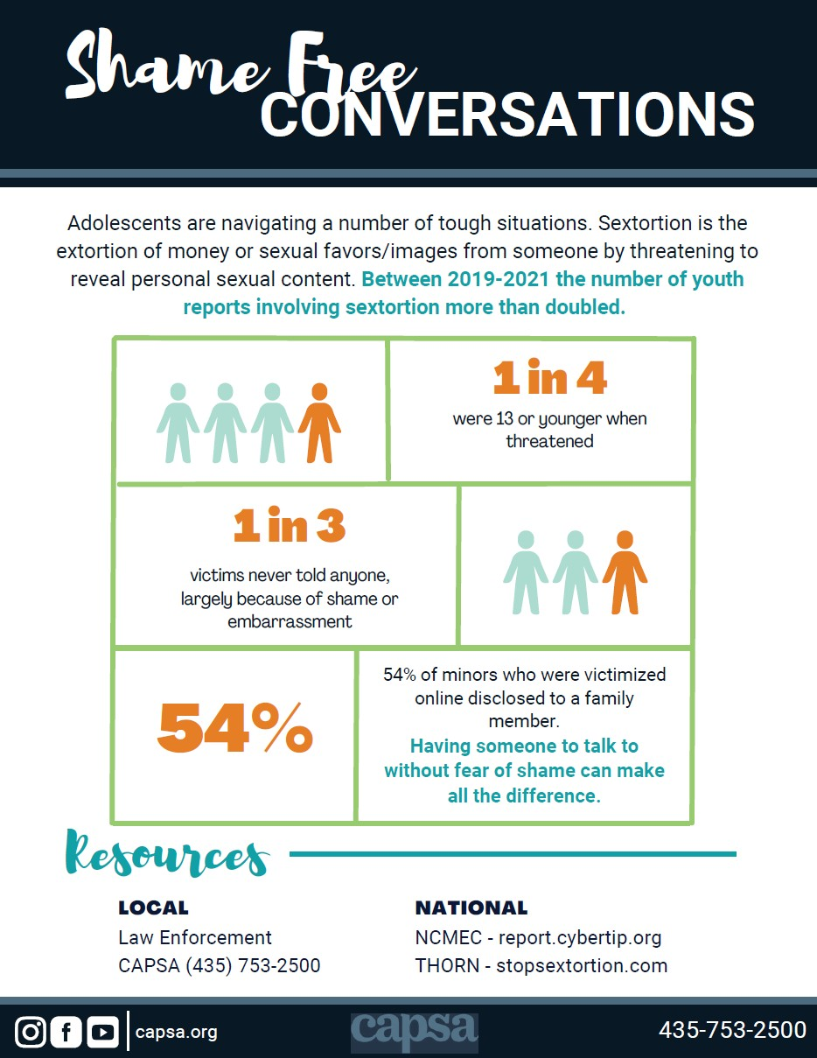

What parents can do
Shame Free Conversations
  Set the tone.
  Timing is important. Don’t try when you/teenager are rushed, hungry, or if you are in a time crunch.
  Remember the conversation should start out of concern and love, not frustration.

Slide 9

What can you do as mayors and government leaders
Help educate the public and community members by:
Increase awareness by including information in city newsletters
Youth councils can participate in organizations like NUVPEC (Northern Utah Violence Prevention & Education Coalition) and CAPSA
Hosting events like National Night Out or other community presentations
Encourage booths that present information about sextortion and internet safety during community events
Support laws that protect youth from on-line predators

Slide 10

Resources to consider
National Center for Missing & Exploited Children (NCMEC)
https://www.thorn.org/
https://www.ccsdut.org
https://www.cachecounty.org/victim-services/
https://www.capsa.org/
Bear River Health Department
Reports can be taken from any law enforcement agency.

Slide 11
Chief Kent Goodrich
435-753-7600
chief@nppdut.gov

